Slide 1
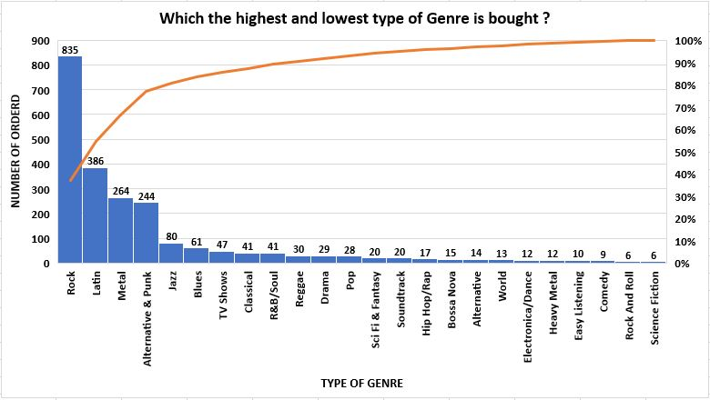
Q1: Which The Highest And Lowest Type Of Genre Is Bought ?
<visualization>
As we have shown in column chart, the highest type of genre was bought is ‘Rock’ with 835 orders, then the second one is ‘Latin’, and its gradual decrease to the lowest type ‘Science Fiction’ & Rock And Roll’ with the same number of orders 6.

Slide 2
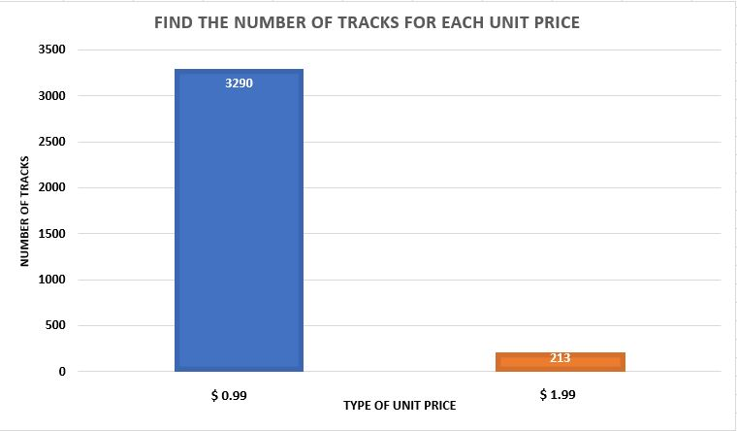
Q2: Find The Number Of Tracks That Have Less Than $1?
<visualization>
As we have shown in column chart, the number of tracks that have less than $1 unit price is 213 tracks, also we have 3290 tracks with a $1.99 unit price.

Slide 3
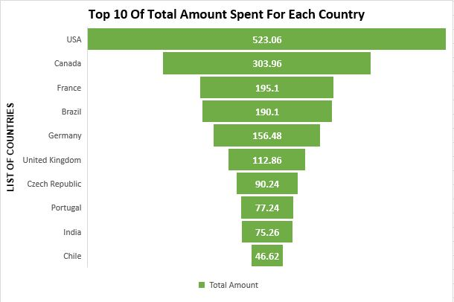
Q3: Find The Top 10 Of Total Amount Spent For Each Country?
<visualization>
As we have shown in funnel chart, the highest of the total amount spent on ‘USA’ with $523.06, then the second one is ‘Canada’ with $303.96, and its gradual decrease to the lowest amount of spent on ‘Chile’ country with $46.62

Slide 4
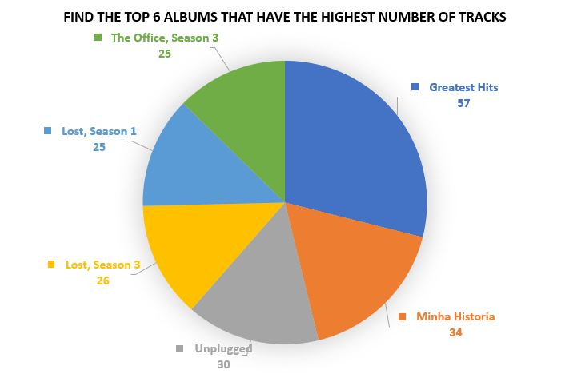
Q4: Find The Top 6 Albums That Have The Highest Number Of Tracks?
<visualization>
As we have shown in pie chart, we have the top 6 Albums, the album with the highest number of tracks is ‘Greatest Hits’ with 57 tracks, and another one is ‘Minha Historia’ with 34 Tracks. Additionally, the lowest albums as shown is ‘The Office, Season 3’ & ‘Lost, Season 1’ with 25 tracks.

